Slide 1

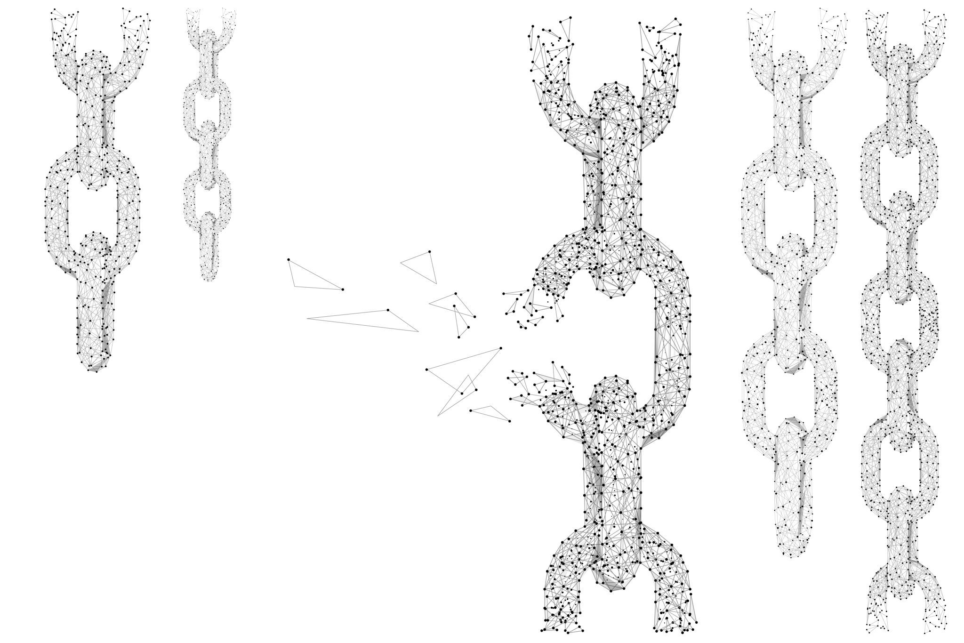
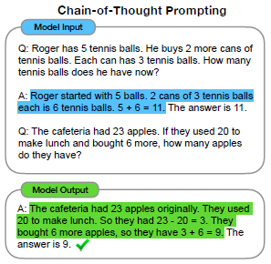
Chain-Of-Thought Prompting Elicits Reasoning in Large Language Models
Google Research / Google Brain
arXiv:2201.11903
#Cluster-of-Stars Paper Reading Group
Human: How would you throw away a redbull?
Explanation: The user has asked me to throw away the redbull, I will move it to the trash.
Plan: 1. find(redbull), 2. pick(redbull), 3. find(trash), 4. put(redbull), 5. done().
Q: A coin is heads up. Conception flips the coin. Kristian does not flip the coin. Is the coin still heads up?
A: The coin was flipped by Conception. So the coin was flipped 1 time, which is an odd number. The coin
started heads up, so after an odd number of flips, it will be tails up. So the answer is no.
Q: There are 15 trees in the grove. Grove workers will plant trees in the grove today. After they are done, there
will be 21 trees. How many trees did the grove workers plant today?
A: We start with 15 trees. Later we have 21 trees. The difference must be the number of trees they planted. So,
they must have planted 21 - 15 = 6 trees. The answer is 6.
Q: What home entertainment equipment requires cable?
Answer Choices: (a) radio shack (b) substation (c) television (d) cabinet
A: The answer must require cable. Of the above choices, only television requires cable. So the answer is (c).

Slide 2

Definitions
Few Shot Prompt/Exemplars: Providing multiple examples of question/answer pairs before asking the model a similar question
Chain of Thought (CoT) Prompting: Including a series of intermediate reasoning steps in a few shot prompt
Standard Prompting: The paper uses this term to describe a few shot prompt that only provides the answers, without the Chain of Thought reasoning of how the answer was generated.
Ablation Study: Investigates the performance of an AI system by removing certain components to understand the contribution of the component to the overall system

Slide 3
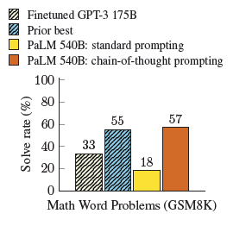
Advantages of Chain of Thought Prompting
Much better accuracy attained with CoT compared to standard prompting once a model has enough parameters.
Relatively few annotations are needed compared to a finetuning approach.
One pretrained model can perform many different tasks by just updating the prompt at inference time rather than expensive finetuning.
If there are problems with the output, being able to view the model's reasoning facilitates debugging.

Slide 4

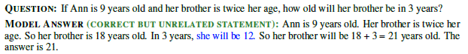
Disadvantages of Chain of Thought Prompting
Worse performance than standard prompting on small models (< 100B parameters)
If a large number of inference requests are planned, at some point the cost incurred from additional CoT few shot reasoning tokens prepended to the prompt during each query may be higher than an initial finetuning cost. (my thoughts)
Causing the model to output additional text than the exact answer increases the chance of non-relevant text being included which could potentially cause parsing issues retrieving the answer
Standard
CoT
CoT

Slide 5
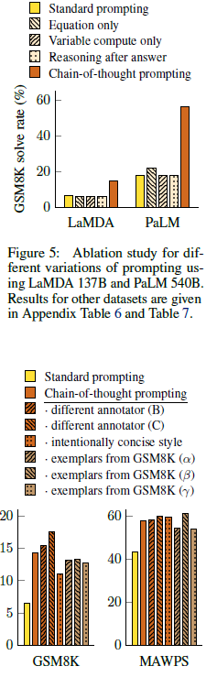
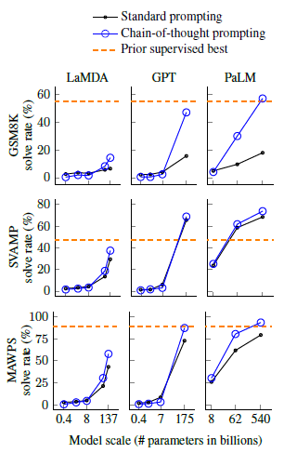
Arithmetic Reasoning
Datasets:
GSM8k – 8,000 grade school math questions answerable by a bright middle school student
SVAMP - math word problems with varying structures
MAWPS - online repository of Math Word Problems
CoT increases the Solve Rate the most for the largest PaLM model while also improving LaMDA and GPT3 results.
Ablation Experiments
Variable Compute Only
Equation Only
Reasoning After Answer
Robustness Checks
Different Annotators
Alternate Exemplars
Intentionally Concise Style

Slide 6
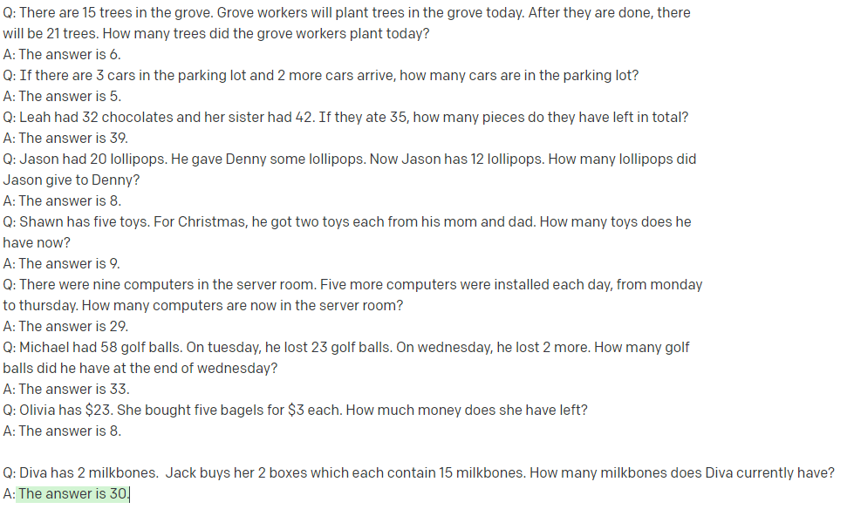
Reproducing results with GPT3 text-curie-001
Standard few shot prompt without chain of thought reasoning:
Wrong!

Slide 7
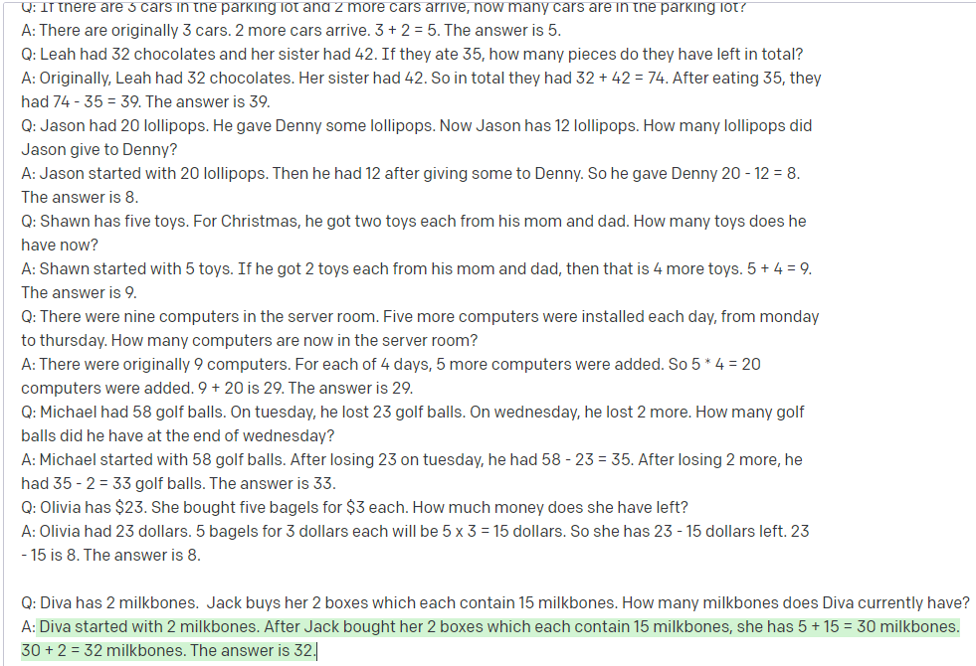
Reproducing results with GPT3 text-curie-001
Few shot prompt with chain of thought reasoning:
Correct answer, incorrect reasoning

Slide 8

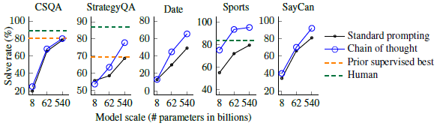
Common Sense Reasoning
Tasks
CSQA: Common sense questions about the world
StrategyQA: Questions requiring a multi step strategy to answer
Date: Inferring a date from a given context
Sports: Determine if a statement about a sport is plausible
SayCan: Natural language to make a robot perform a task
CoT prompting outperformed an unaided human sports enthusiast on sports understanding (95.4% vs 84%)!

Slide 9
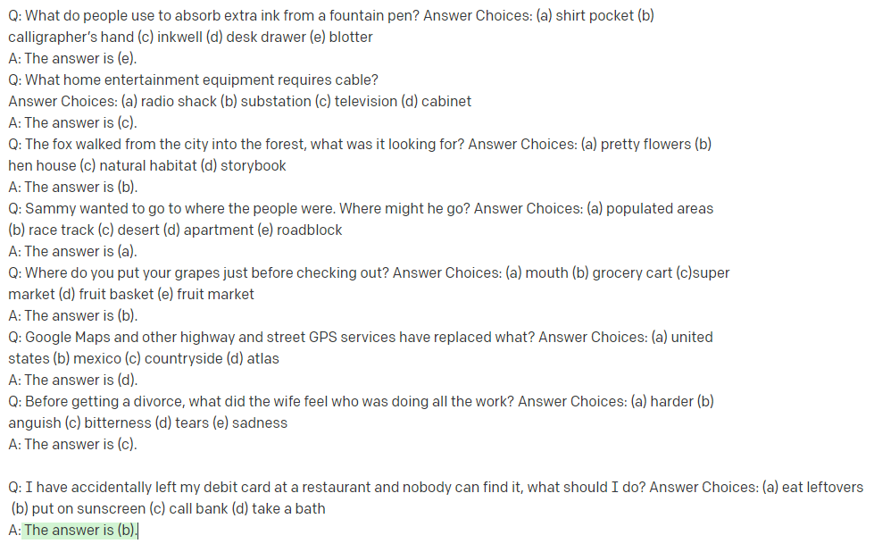
Reproducing Common Sense results with GPT3 text-babbage-001
Standard few shot prompt without chain of thought reasoning:
Wrong!

Slide 10
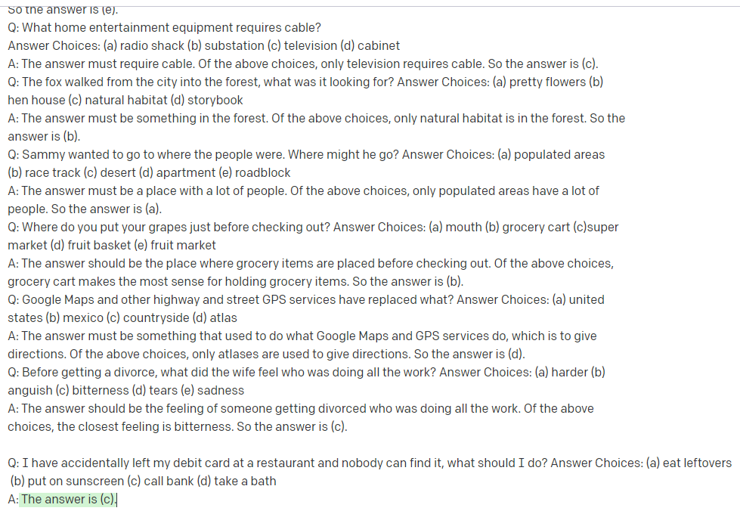
Reproducing Common Sense results with GPT3 text-babbage-001
Few shot prompt with chain of thought reasoning:
Correct, no reasoning outputted

Slide 11
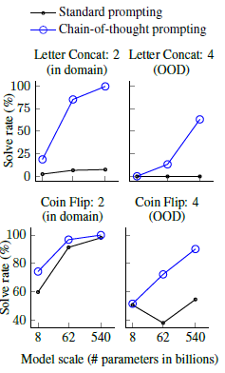

Symbolic Reasoning
Task #1 - Coin Flip heads or tails?
Task #2 – Name Last letter concatenation "Jack Youngblood" = "kd"
Performed less well on "out of domain" tasks where the number of coin flips or words differed from the training data. However, in all cases including Chain of Thought prompting met or exceeded the solve rate from Standard Prompting.

Slide 12
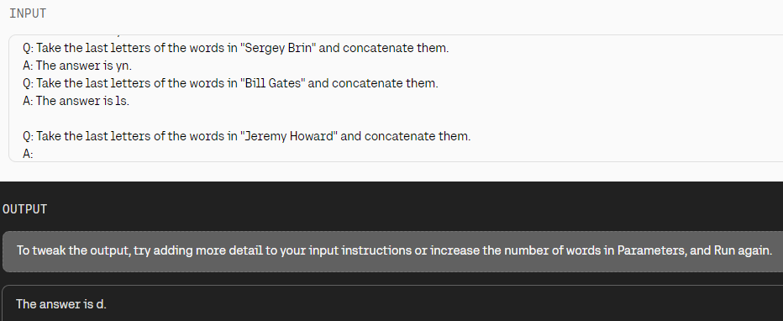
Reproducing Symbolic Reasoning results with Cohere
Standard Few shot prompt without chain of thought reasoning:
Wrong!

Slide 13
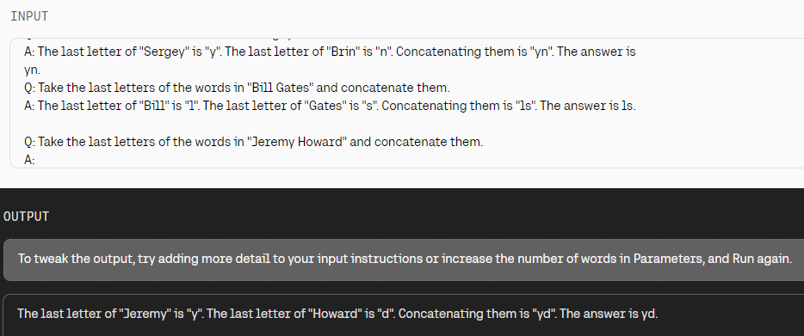
Reproducing Symbolic Reasoning results with Cohere
Few shot prompt with chain of thought reasoning:
Correct!

Slide 14
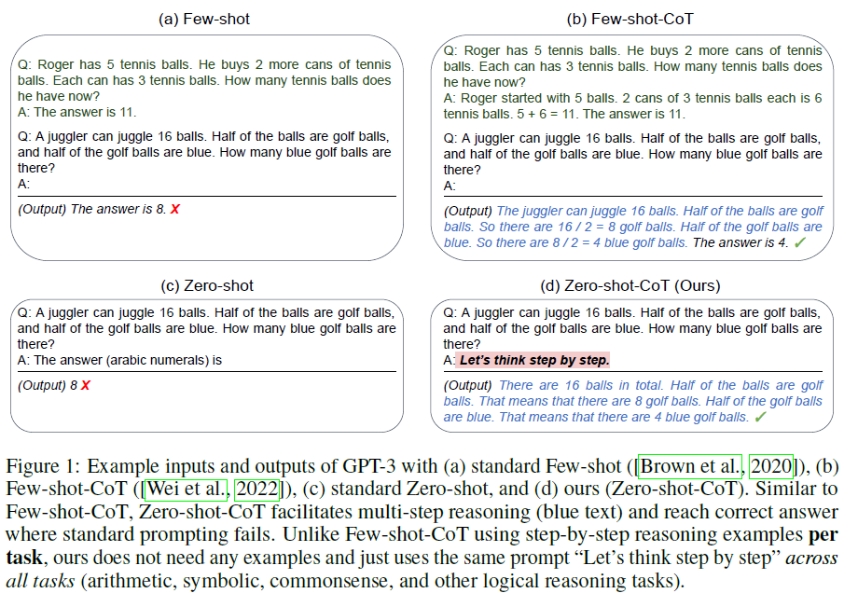
arXiv:2205.11916
Large Language Models are Zero-Shot Reasoners
arXiv:2205.11916
Google Research, Google Brain, University of Tokyo

Slide 15

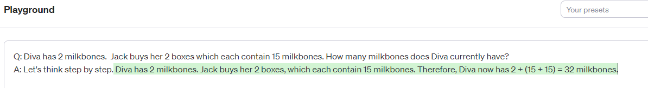
Reproducing results with GPT3 text-davinci-003
Standard zero shot prompt without zero shot chain of thought reasoning:
Wrong!
Zero shot chain of thought reasoning:
Correct!

Slide 16
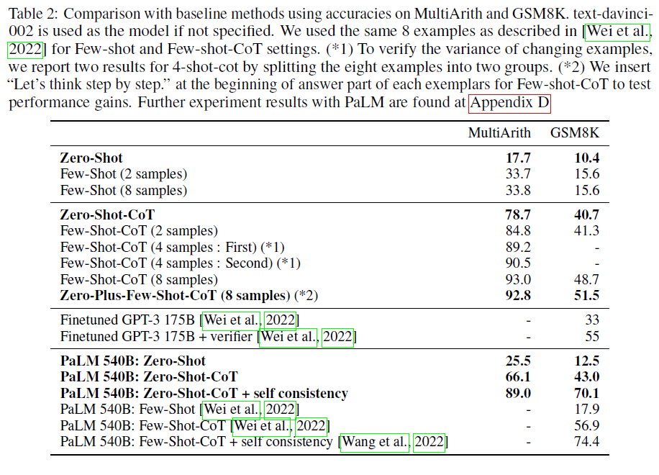

Slide 17
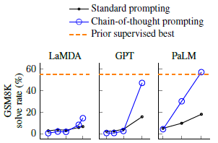
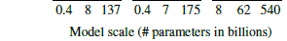
Conclusion
Chain of Thought prompting helps the most under the following scenarios:
A language model has a large number of parameters
The task requires multistep reasoning
The scaling curve is relatively flat (adding additional parameters doesn’t significantly improve the results).

